Slide 1


HOW SNOWFLAKE MEETS ASSET MANAGEMENT CHALLENGES
DEMO
Antoine LENTSCHENER | February 2024,

Slide 2
Agenda
Introduction
Demo
Key Benefits
Appendix

Slide 3




Challenges in Asset Management
Performance and Returns
Competition and Fee Pressure
Technology and Digital Transformation
Generating attractive returns while managing risks
Facing intense competition and demands for lower fees.
Adapting to technological advancements and digitalization.
Regulatory Compliance
Changing Investor Preferences
Navigating complex and evolving financial regulations.
Meeting the demand for personalized and sustainable investment solutions.
Notes:
Pression sur les Marges : Avec la baisse des frais de gestion et la concurrence accrue, les gestionnaires d'actifs sont sous pression pour augmenter leur efficacité opérationnelle et réduire leurs coûts.
Réglementation Compliquées : Le paysage réglementaire est de plus en plus complexe et exigeant, obligeant les gestionnaires d'actifs à assurer une conformité sans faille tout en restant agiles.
Attentes Élevées des Clients : Les investisseurs demandent davantage de transparence, de personnalisation et de performance, poussant les gestionnaires d'actifs à adopter des technologies avancées pour répondre à ces attentes.
Gestion et Analyse des Données : L'explosion des volumes de données nécessite des outils plus sophistiqués pour les analyser efficacement, afin de tirer des insights actionnables pour les stratégies d'investissement.
Pourquoi baisse des frais ?
Gestion passive : La majorité des ETF sont des fonds indiciels qui suivent passivement un indice boursier. Cela signifie qu'ils cherchent à répliquer la performance d'un indice de marché spécifique, sans essayer de le battre. Cette gestion passive réduit le besoin d'analystes et de gestionnaires de fonds pour sélectionner activement les actions, ce qui diminue les coûts opérationnels.
Efficacité Fiscale : Les ETF bénéficient souvent d'une structure fiscale plus efficace par rapport aux fonds mutuels traditionnels, particulièrement dans des juridictions comme les États-Unis.
Les investisseurs achètent et vendent des ETF directement sur le marché boursier, ce qui peut réduire les frais de transaction par rapport aux fonds mutuels qui nécessitent souvent des intermédiaires.
Quelles régulations pour plus de transparence ?
MiFID II (Markets in Financial Instruments Directive II) : Cette directive vise à améliorer la transparence des marchés financiers dans l'UE et à protéger les investisseurs. MiFID II exige une divulgation détaillée des coûts et des charges associés aux investissements, ce qui inclut les frais de gestion.
Rule 12b-1 (SEC) : Bien que controversée, cette règle réglemente les frais que les fonds mutuels peuvent prélever pour la commercialisation et la distribution. Union Européenne

Slide 4
Agenda
Introduction
Demo
Key Benefits
Appendix

Slide 5
What will you see?
Accelerate & modernizing Investment Processes
MARKET INTELLIGENCE
INVESTMENT JOURNEY
OPERATIONS
New investments research
Due
Diligence
Portfolio
Monitoring
Administration, Client Servicing, Reg Reporting
Web scraping + AI Reco RAG | Risk Analysis leveraging Document AI | Performance Analysis Data Sharing with LPs | Data Governance Regulatory Reporting
GOVERNED AND SECURED
INTERNAL DATA
EXTERNAL DATA
Structured
Unstructured
Structured
Unstructured Data
Quant Platform
PMS
OEMS
Annual Reports
Audits Reports
Carbon footprint
Market Data on Marketplace
Partners Data through Data Sharing
Web scraping
Industry Reports
Carbon footprints
Notes:
Due diligence : phase d'analyse approfondie visant à évaluer tous les aspects financiers, juridiques, et opérationnels d'une entreprise cible avant de réaliser un investissement. Voici les principales activités réalisées pendant la due diligence.
Analyser les actifs tangibles de l’entreprise ici en l’occurence les machines de production qui permettent de fabriquer les différents équipements Confirmer non seulement la valeur réelle de l'entreprise mais aussi d'identifier d'éventuels risques liés aux actifs qui pourraient affecter la décision d'investissement.

Slide 6
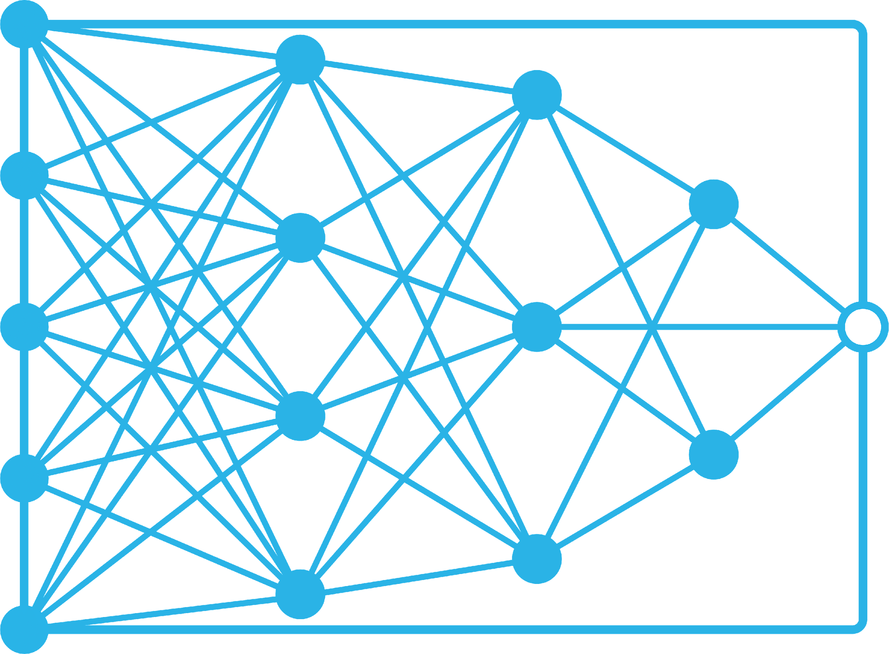
Why Snowflake for Asset Management?
Single Data Platform
Scale multiple workloads across the business, from quant research & trading to regulatory reporting, with a single copy of all your data
Data Access &
Collaboration
Enables secure & shared data ecosystems facilitating collaborative investment insights and strategy development across firms, partners
Security & Governance
Protect, store, and access all portfolio, reference, market, and risk data with strict controls that meet compliance & risk needs
Native AI Platform Maximise your organisation's AI potential by leveraging our advanced platform capabilities designed for any AI maturity level, enabling quick deployment of customised AI solutions

Slide 7

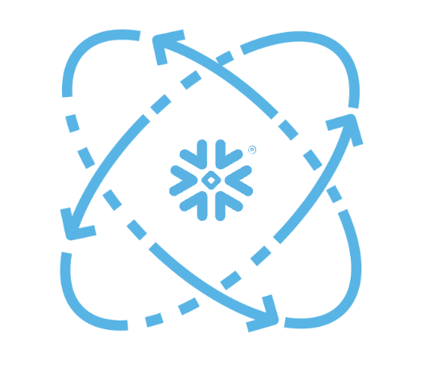
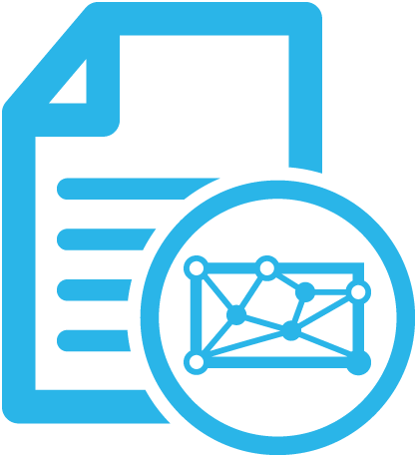
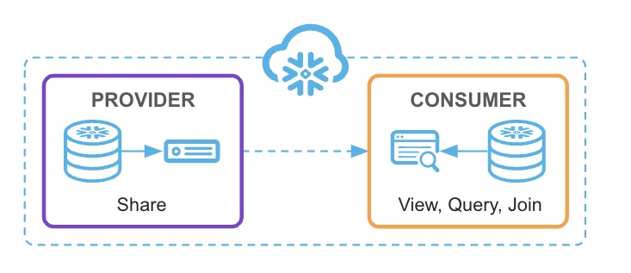
Snowflake added value for Asset Managers
PLATFORM
KEY FEATURES
Multi-cluster Concurrency
Cost-effective
and Flexible
Snowflake Cortex
Document AI
Data Sharing
& Market Place
Power all workloads across the front, mid, and back office without contention, with an architecture that separates data from compute
Tailor to specific workload needs and budgets by scaling up and down depending on the workload requirements
Empower Analysts to enhance decision speed and quality with easy-to-use yet powerful SQL functions, and share risk forecasting insights through integrated analytics/BI tools
Improve due diligence & security risk assessments by extracting actionable insights from unstructured data sets without manual intervention, streamlining the analysis process and accelerating critical decision making.
Revolutionize asset management by enabling effortless data sharing and marketplace access, streamlining collaboration, driving decision-making and operational efficiency.
Business Value
Notes:
Snowflake’s platform is what makes this all possible. One single platform to meet your most critical requirements:
It needs to be fast for any workload. Performance is non-negotiable and a platform needs to deliver that speed no matter what the job is, what else is running, or how large the data volumes are.
It needs to just work. Your business cannot rely on a platform that requires manual intervention to not just keep it running but keep it running optimally. You need automations to operate at scale, stay up and running no matter what, and continually improve and deliver new efficiencies over time.
And it needs to connect your business to what matters. Platforms should catalyze access and collaboration across your business - whether it’s connecting analysts to data scientists, regions or different cloud environments, or new data. This needs to be seamless and secured every step of the way
So let’s take a closer look at the Snowflake platform and how it delivers on these requirements.

Slide 8
THANK YOU

Slide 9
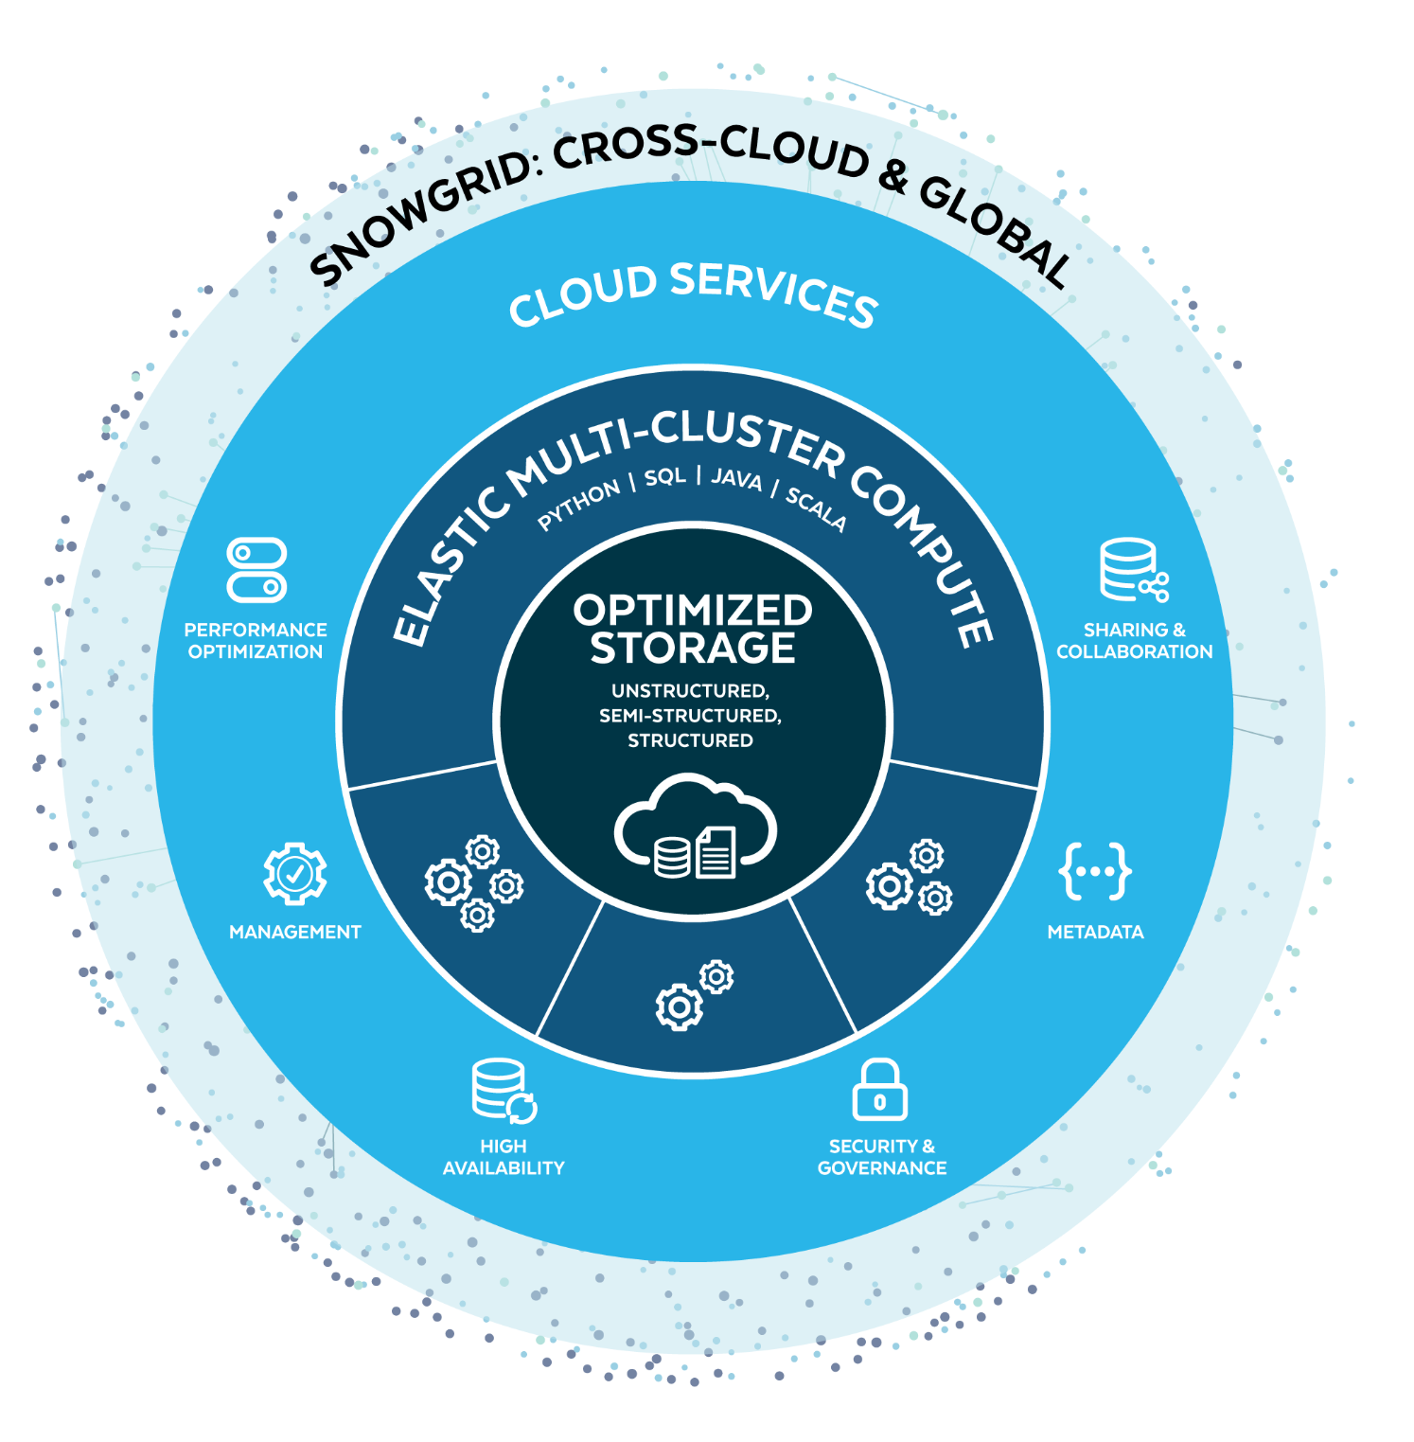
Snowflake Platform Architecture
Built from the ground up to take advantage of the cloud
SNOWGRID
Consume and share data across AWS, Azure and GCP clouds with no ETL and enabling cross cloud continuity
Increase data collaboration while reducing costs and revealing new insights
CLOUD SERVICES
Near zero maintenance, easier for IT teams to implement and run, single governance model
You and the teams who support you spend less time managing technology
MULTI-CLUSTER COMPUTE
Isolated compute removes contention, work at the right scale, in the language of your choice
You don’t wait for other work to finish, if you need the results in half the time, simply scale up
STORAGE
No capacity constraints, encrypted by default, multi-data centre resilience by default
IT teams don’t need to spend time planning, procuring and setting up infrastructure

Slide 10



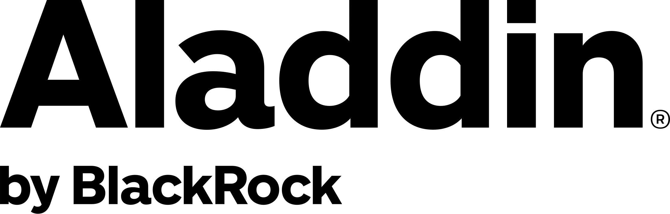







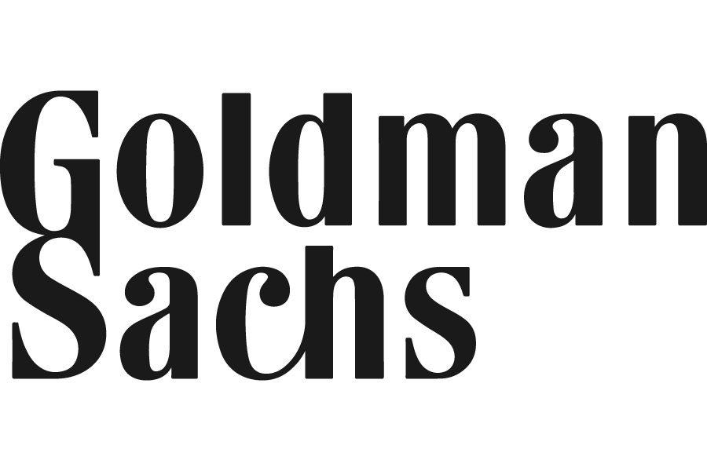
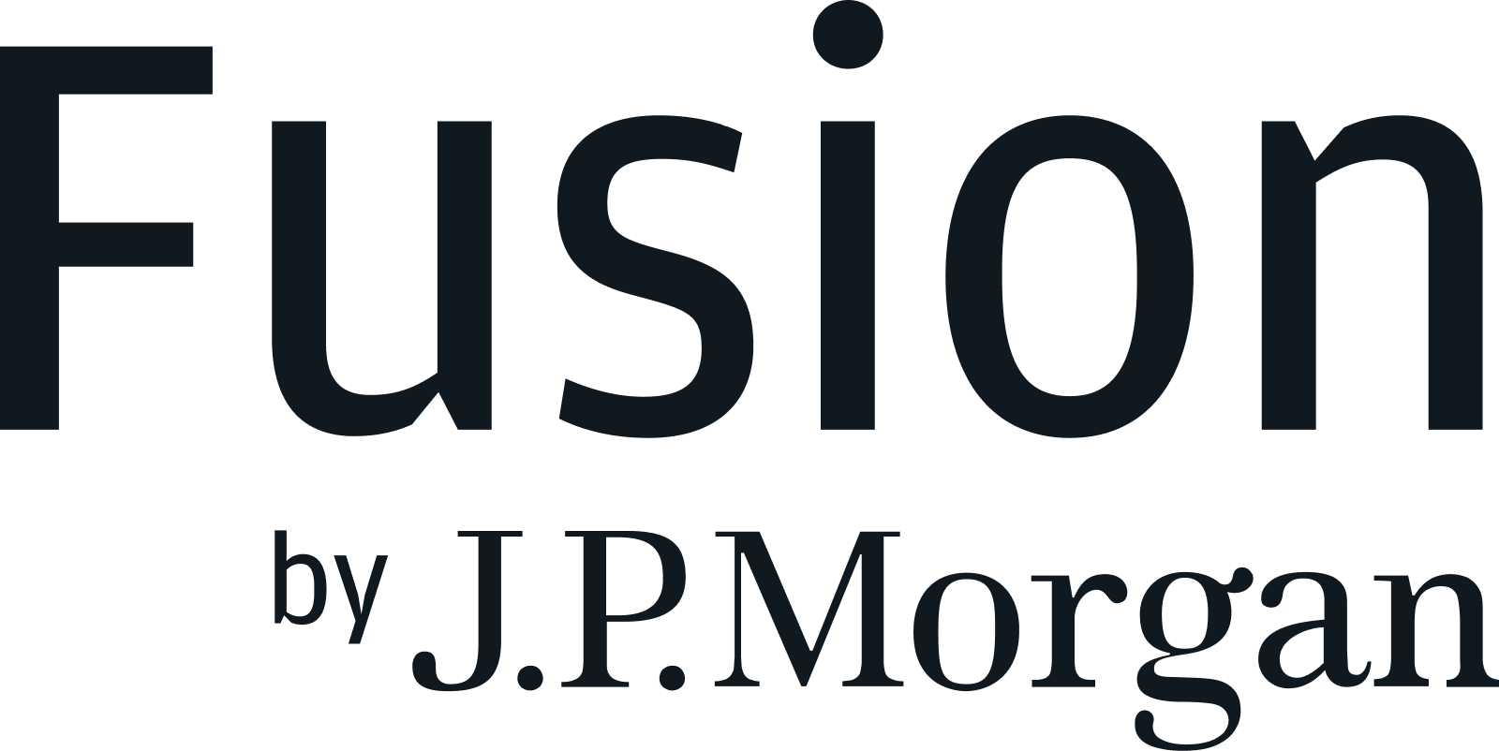
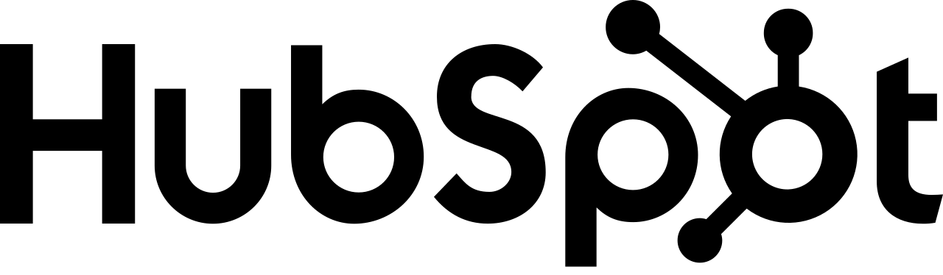





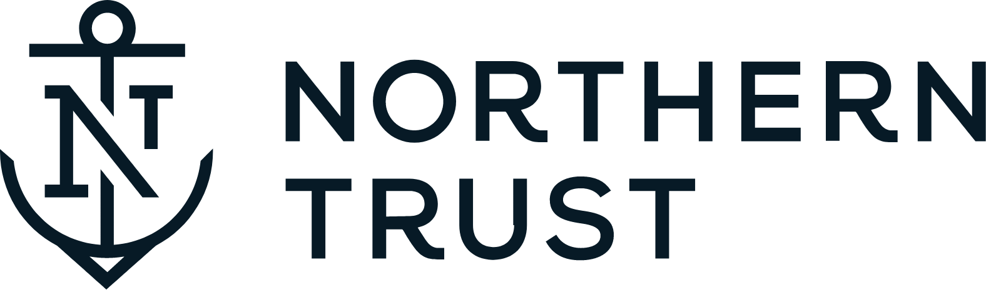

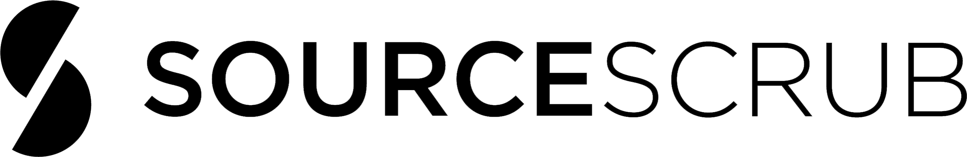













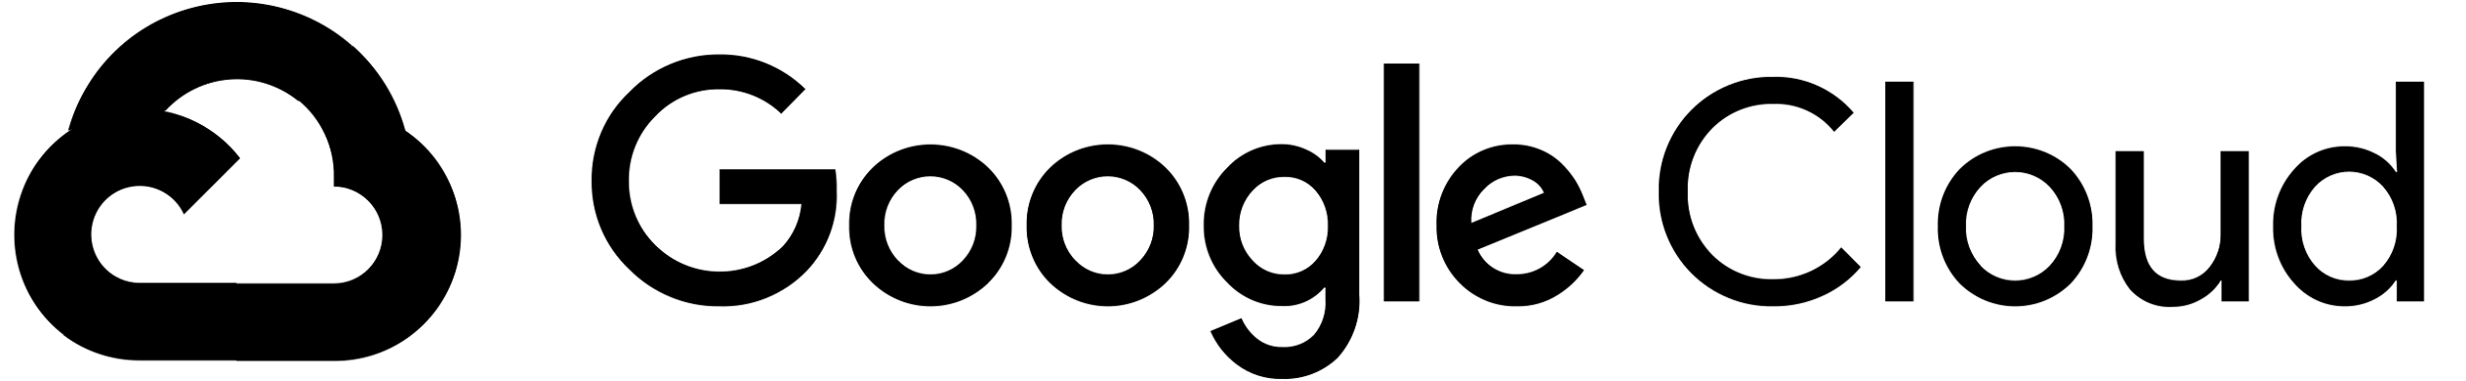

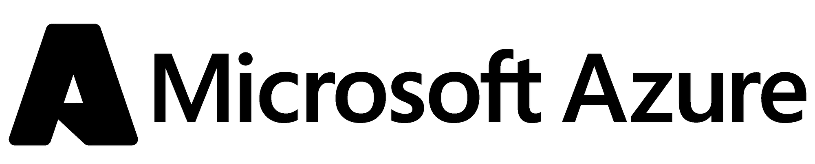
Financial Services Data Cloud
For Asset Management
Use Cases
Your Data
Data Providers
Service & Solution Providers
Ecosystem Participants
Banks
Quantitative Research
Investment Analytics
Investor 360
ESG
Regulatory Reporting
Asset Managers
Other Institutional Investors
Insurers
Corporates
Clearing Houses
Cloud Providers
© 2024 Snowflake Inc. All Rights Reserved
Notes:
To solve the most prominent challenges in our industry today!
Through now a single instance of data, we are enabling interoperability,, across this financial services ecosystem - giving organizations a frictionless data experience ... and a single source of truth.

Slide 11
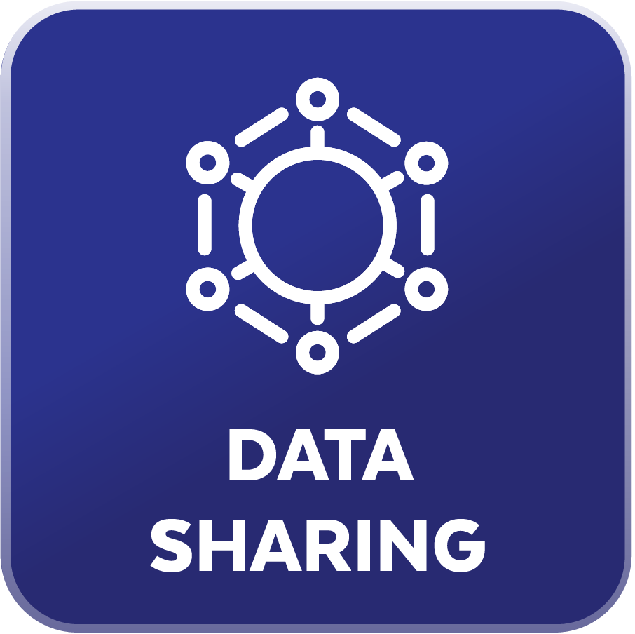

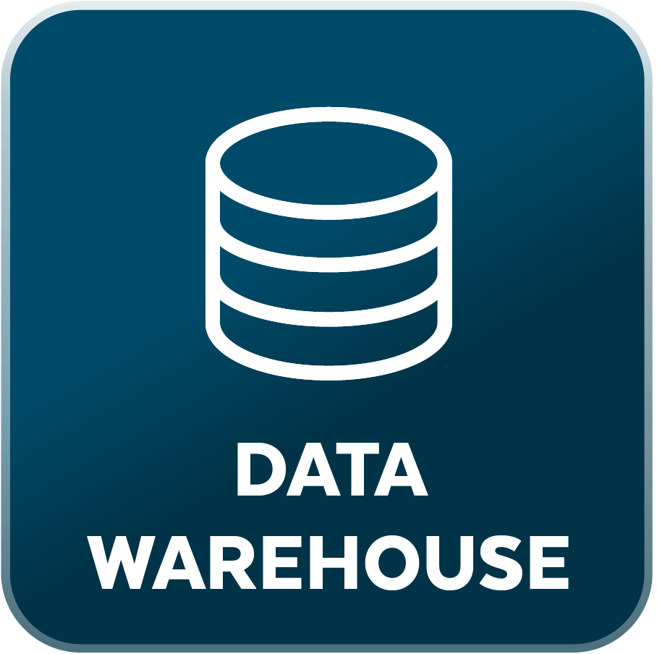
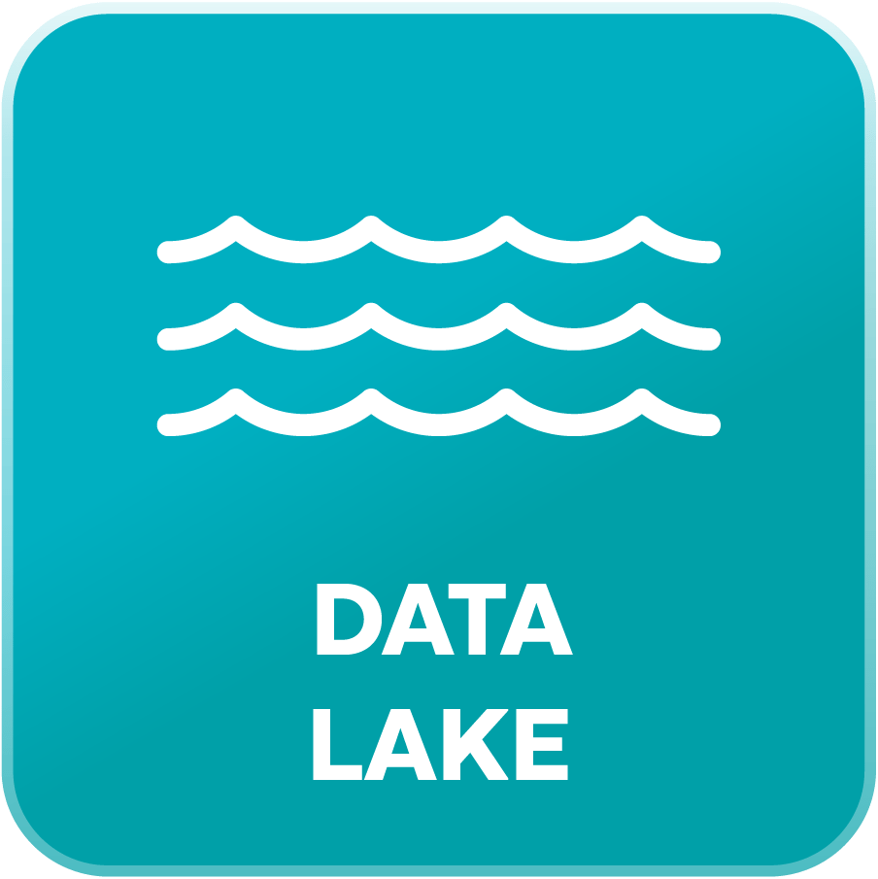
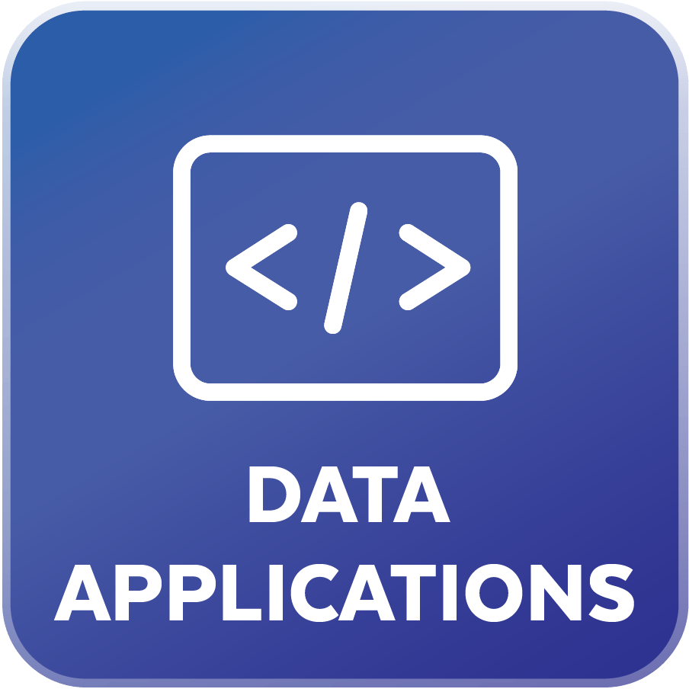



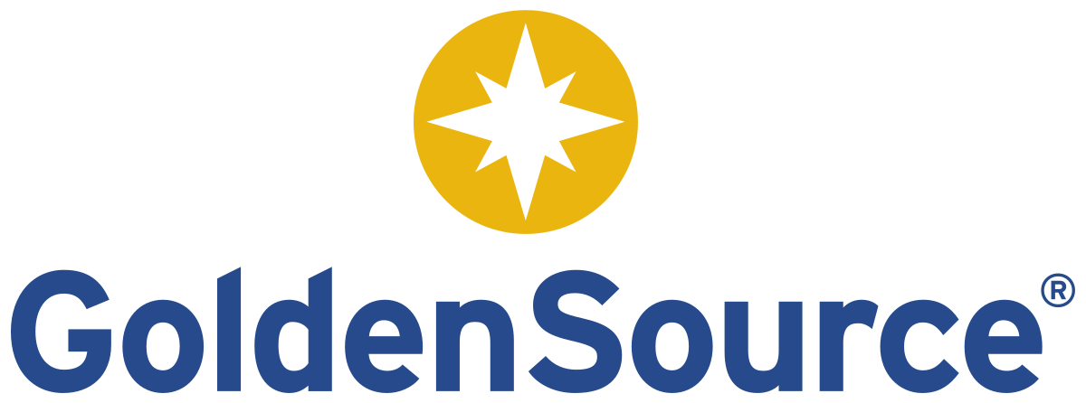


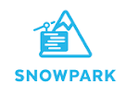
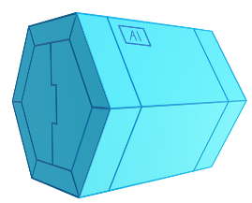


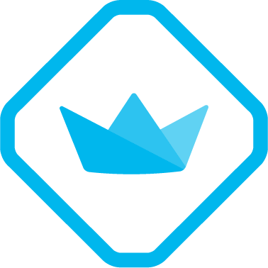
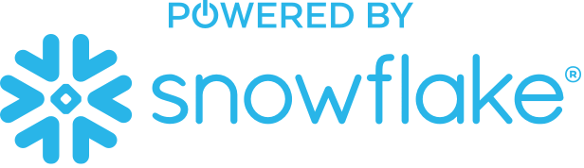

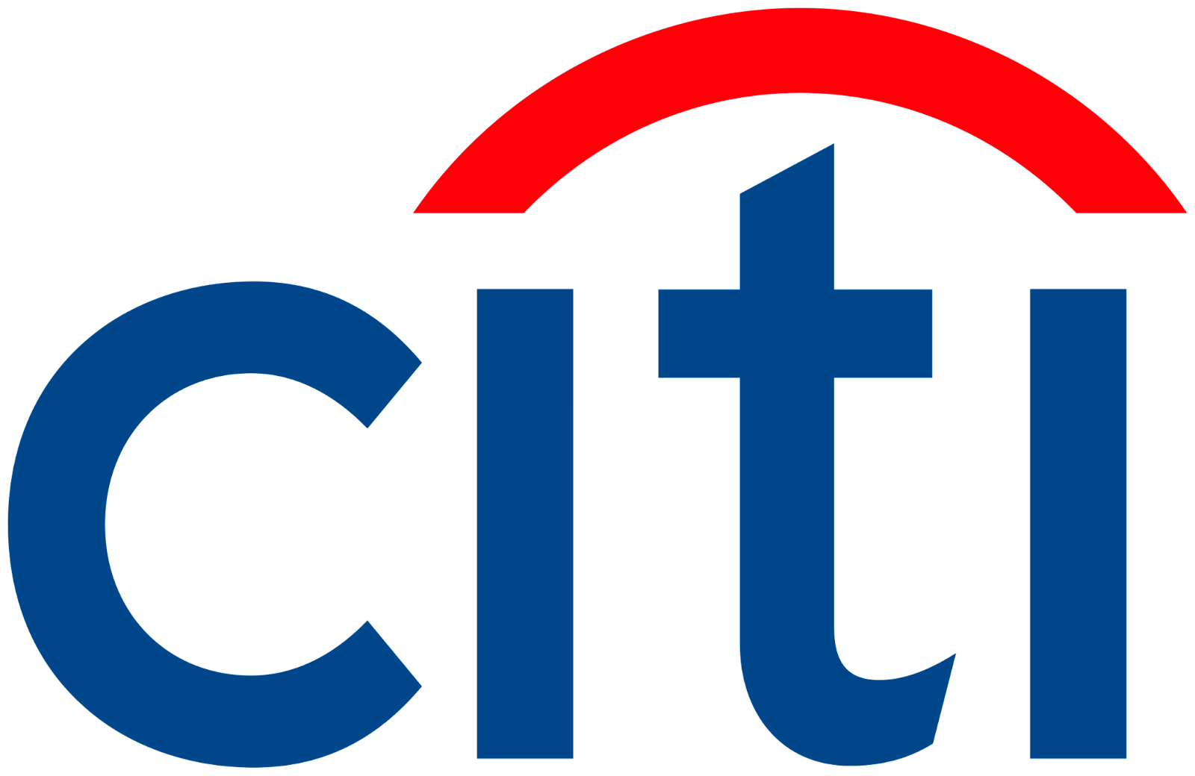





Reference Architecture
SOURCE YOUR DATA
AGGREGATE DATA
BUILD YOUR PRODUCTS
SHARE AND EXPOSE
Investment Management Platforms
EDM Providers
Custodian Bank Platforms
Third-Party Data
DATA REPOSITORY
ML & ANALYTICS ENGINE
Marketplace or Private Share
APPLICATIONS
RAG Models
For Research
Due Diligence Info Extraction
ESG Data
Real-time Pricing
Historical Pricing
Reference Data
Fundamentals
Estimates
Portfolio Data
Trade Data
Customer Data
Other Proprietary Data
ESG Score Calculation
Performance Analytics
Portfolio Construction
Snowpark Container Services
Document AI for
Reports & documents
ESG Investment Strategy
Performance Monitoring
Data Ingestion
Data Transformation
Risk Management
Security Controls for PII
Streamlit or Native Apps for front-end
Data Monetization via Marketplace
Common Validation, Business Logic, and Rules Library
Data Governance
A SINGLE DATA PLATFORM

Slide 12
What will you see?
Accelerate & modernizing Investment Processes
MARKET INTELLIGENCE
INVESTMENT JOURNEY
OPERATIONS
Investment
Research
Due Diligence
Portfolio Monitoring
Administration, Client Servicing, Reg Reporting
MARKET INTELLIGENCE
INVESTMENT JOURNEY
OPERATIONS
Investment
Research
Due Diligence
Portfolio Monitoring
Administration, Client Servicing, Reg Reporting
MARKET INTELLIGENCE
INVESTMENT JOURNEY
OPERATIONS
Investment
Research
Due Diligence
Portfolio Monitoring
Administration, Client Servicing, Reg Reporting
MARKET INTELLIGENCE
INVESTMENT JOURNEY
OPERATIONS
Investment
Research
Due Diligence
Portfolio Monitoring
Administration, Client Servicing, Reg Reporting

